Slide 1

Testing Fundamentals

Slide 2
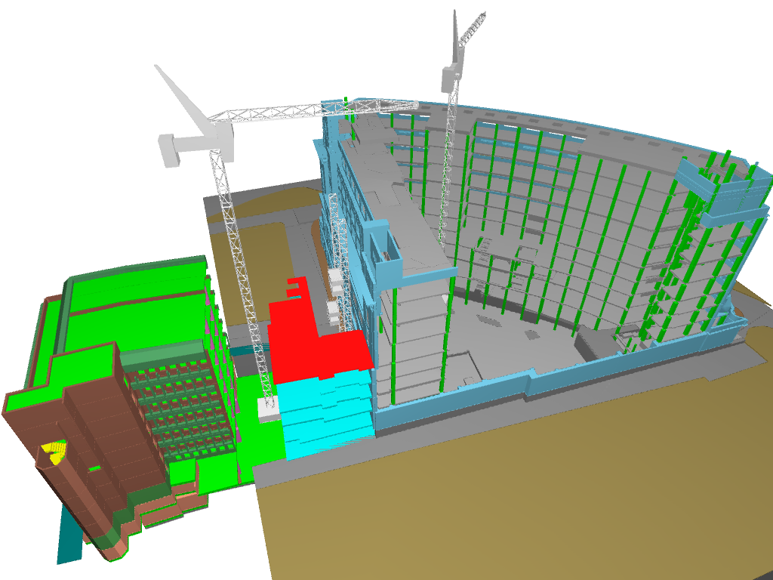
Who does testing
Testing can done with various s

Slide 3

ujhbbjbkjbj

Slide 4
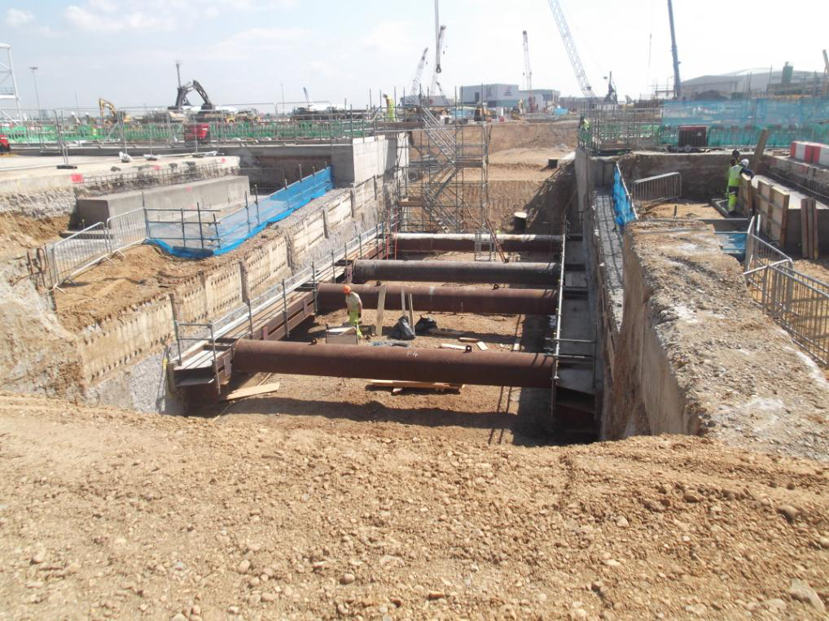
What is testing
Testing is process of evaluating a system or its component(s) with intent to find that weather it satisfies the specified requirement or not
“ A process of analysing a software item to defect the differences between existing and required conditions (that id defects/error/bugs) and to evaluate the features of the software item”

Slide 5


Slide 6
Klkjlkjlj jlj
Jhkuhiol
Oihoijh
Ojli
Ojo
;jjop
K

